Slide 1
PolyGen
Nuruzzaman Sakib
Department of Mechanical Engineering, University of Alabama, Tuscaloosa, AL

Slide 2
PolyGen
Introducing PolyGen: Your Gateway to WSe₂ Monolayer Polycrystal Grain Boundary Structures
Welcome to PolyGen, a software for 2D TMDC materials science research, Designed by Nuruzzaman Sakib and Dr. Kasra Momeni.
PolyGen empowers scientists and engineers to explore the fascinating world of WSe₂ monolayer grain boundary structures with unparalleled ease and precision. This innovative software utilizes computational techniques to create highly realistic and customizable simulations, offering an invaluable platform for studying the behavior and properties of these essential materials.
Whether you are a seasoned researcher or a budding enthusiast, PolyGen can help you generating complex WSe₂ monolayer grain boundary structures, accelerating scientific discovery and advancing our understanding of these remarkable materials.

Slide 3
PolyGen
Readme.txt
Installation:
First run "python3 setup.py build_ext --inplace" in a terminal with "Codes" directory as current directory to create the _cPolyUtils module created by Ashivni Shekhawat et al. Cite as - "Large-scale experimental and theoretical study of graphene grain boundary structures, Colin Ophus, Ashivni Shekhawat, Haider Rasool, and Alex Zettl, Phys. Rev. B 92, 205402“
Prerequisites:
Install NumPy (pip3 install numpy)
Install ASE (pip3 install ase)
Install ovito using (pip3 install ovito)
Install LAMMPS (See LAMMPS website on how to install)
Instruction for use:
Change the bash file “PolyGen.sh" according to the Dimension and number of grains in the polycrystal. Just change the “dimension” and “no_of_grain” in the bash script.
run bash PolyGen.sh from outside of Codes directory. Do not change the folder and PolyGen.sh location. If you do, then change the bash script as well to accommodate the change.
After that, you need to run energy minimization of the created Polycrystal GB structure before using in LAMMPS calculation.

Slide 4
Modules
_cPolyUtils.c
setup.py
polyCrystal.py
structure_gen_poly.py
This code can generate the polycrystal for graphene with pentagon-heptagons only. Which is the common defect type in GBs found in CVD grown graphene structures.
For better understanding of this portion of code, please read - "Large-scale experimental and theoretical study of graphene grain boundary structures, Colin Ophus, Ashivni Shekhawat, Haider Rasool, and Alex Zettl, Phys. Rev. B 92, 205402"

Slide 5
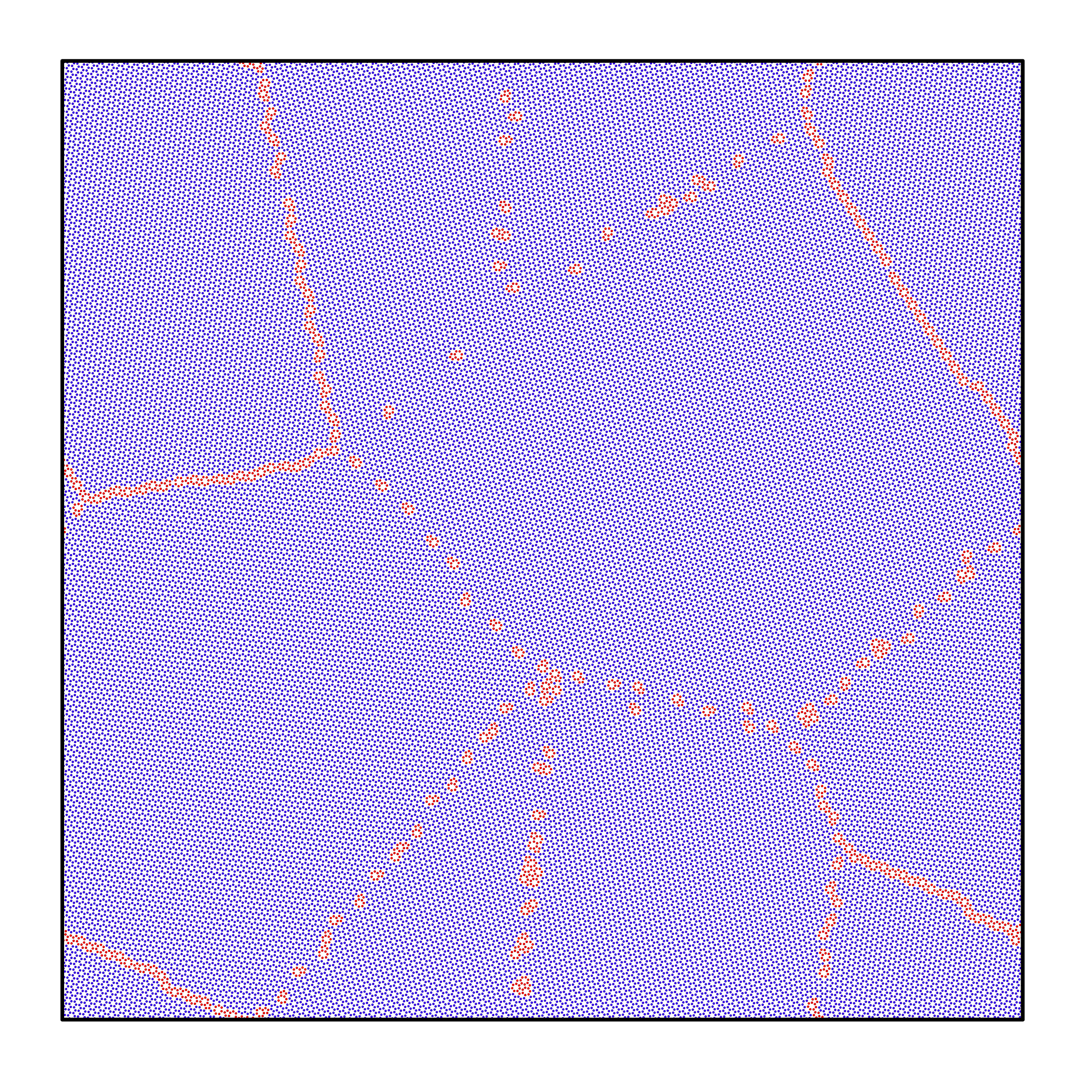
Modules
Cfg2lmp.py
This will convert the cfg file to lmp file with gb atoms in a separate file.
in.min
This is a simple lammps script to minimize the structure generated by Ashivni et al.

Slide 6
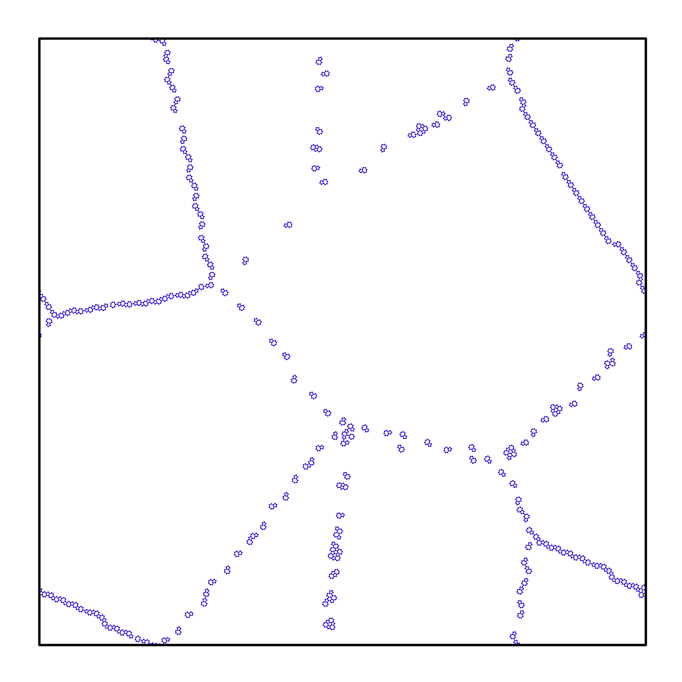
Modules
ovito_data_extract_poly.py
This python code imports ovito python library and can generate neighbor list based on cutoff distance (here we used 1.85 A for graphene) also remove the unnecessary atoms from the GB area.

Slide 7
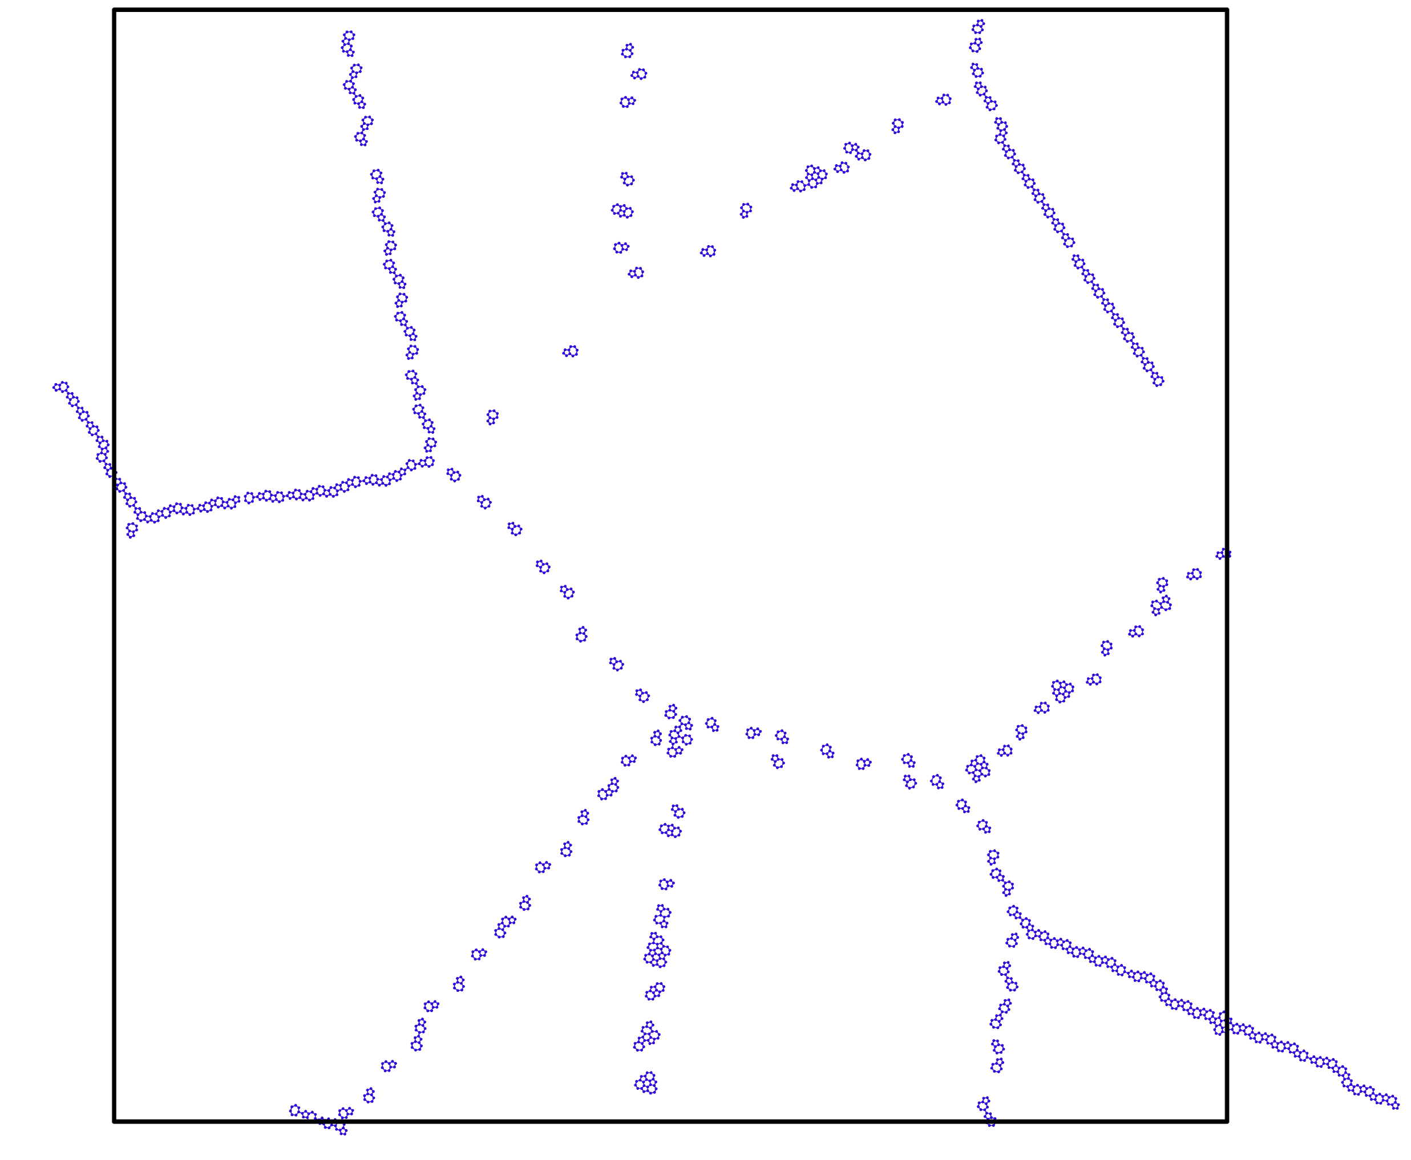
Modules
periodicpolyGrain.py
This code unwrap the GB atoms if they form bond with an atom which is in another side of the boundary.

Slide 8
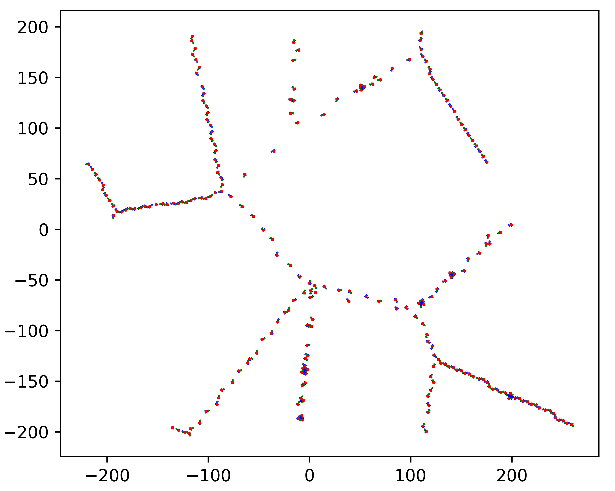
Modules
identify_penta_hepta_poly.py
This code identifies the pentagons and heptagons in GB area. It will output the coordinates of the pentagons and heptagons in a separate text file and outputs a visualization of the pentagons and heptagons.

Slide 9
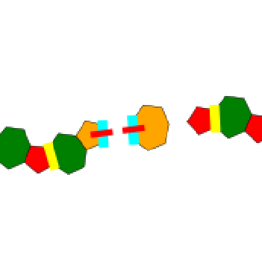
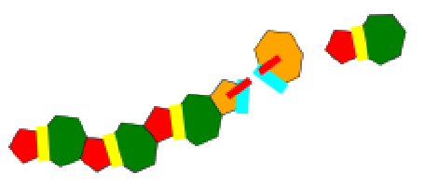
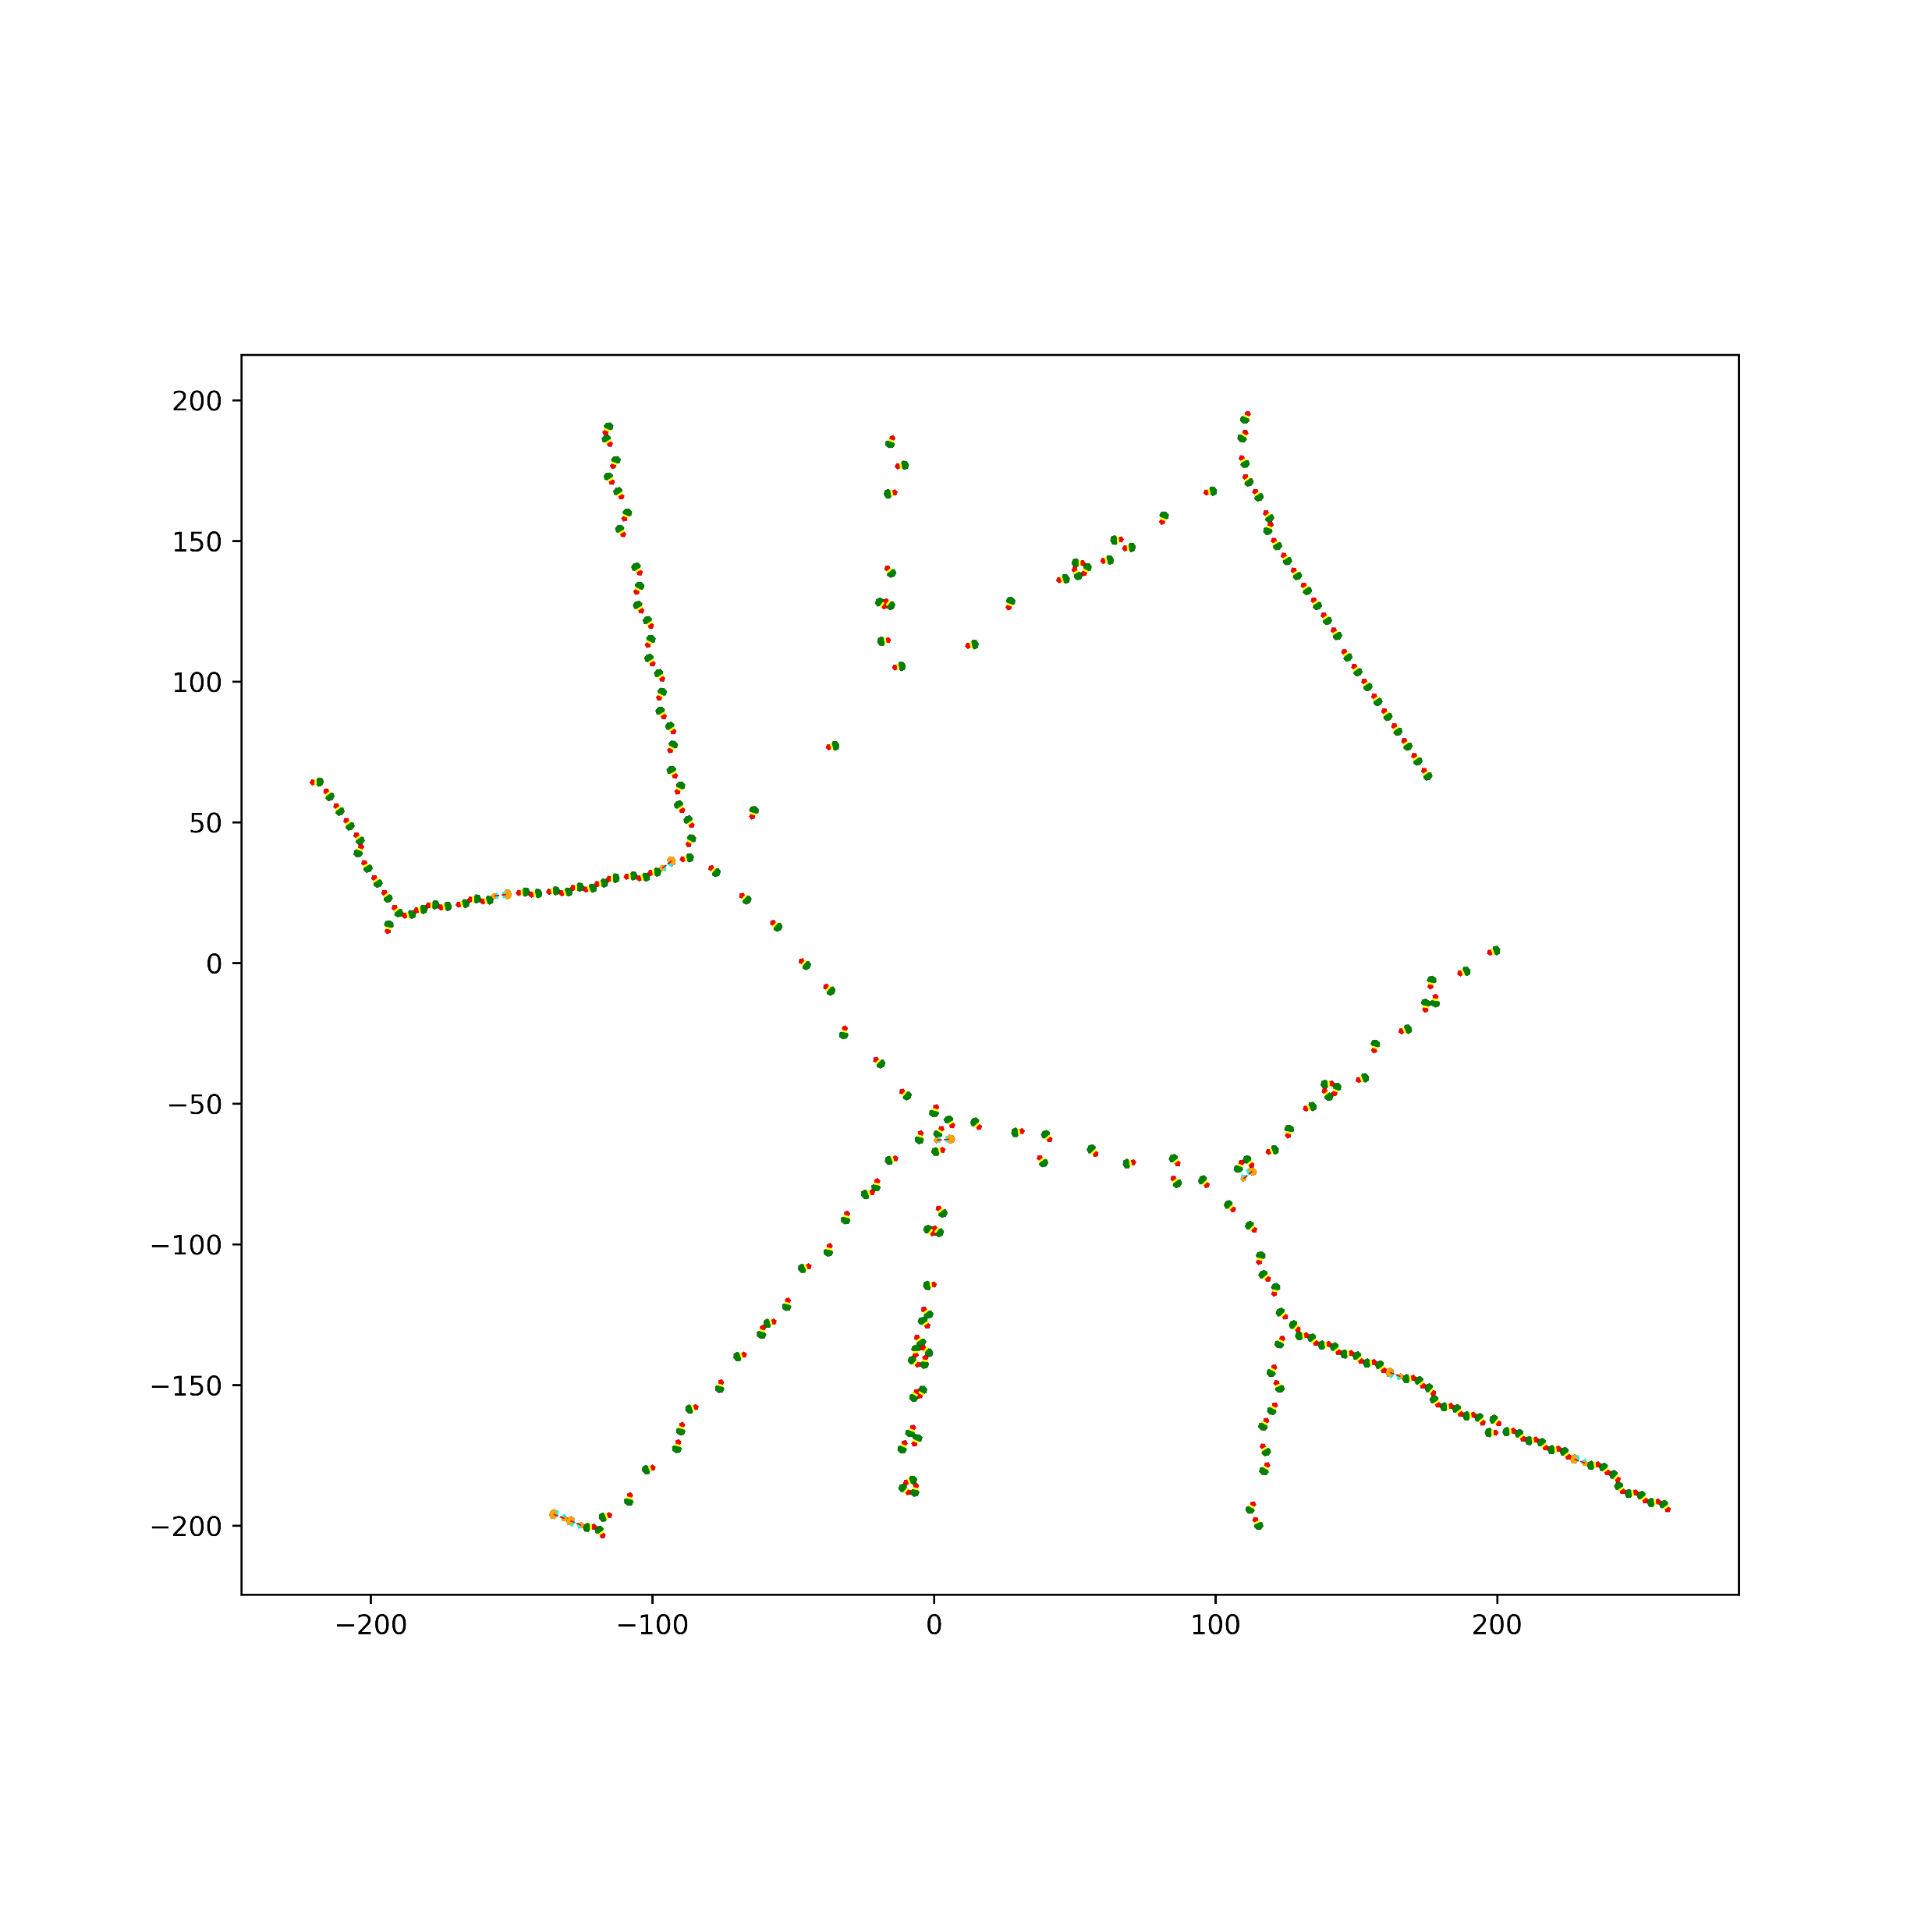
Modules
pair_find.py
This will identify the pentagon-heptagon pairs. We used Hungarian algorithm to construct the pair where center to center distance of pentagon and heptagon was used as cost function.
Regular Pentagon-Heptagon- Shared Edge-Marked as Yellow
Hexagon in between the pair- Shared Edge- Marked as Cyan

Slide 10
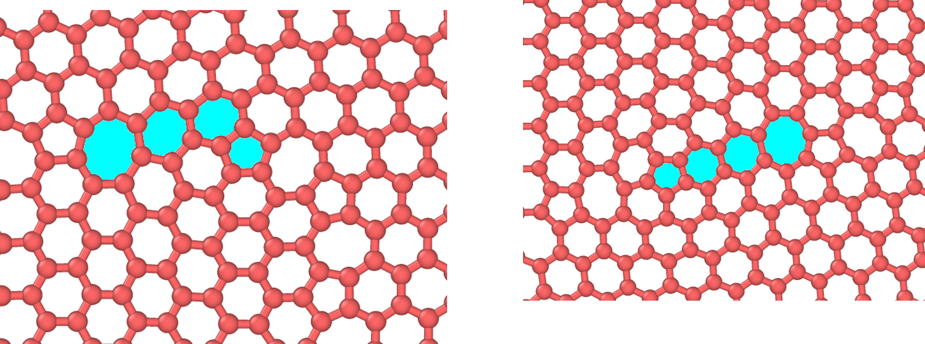
Modules
NNFind_1.py/NNFind_2.py/NNFind_3.py
This three code works only when there is a pair of pentagon-heptagon pair with two or more hexagons in between them. It can extract the shared edge of the hexagons if needed.

Slide 11
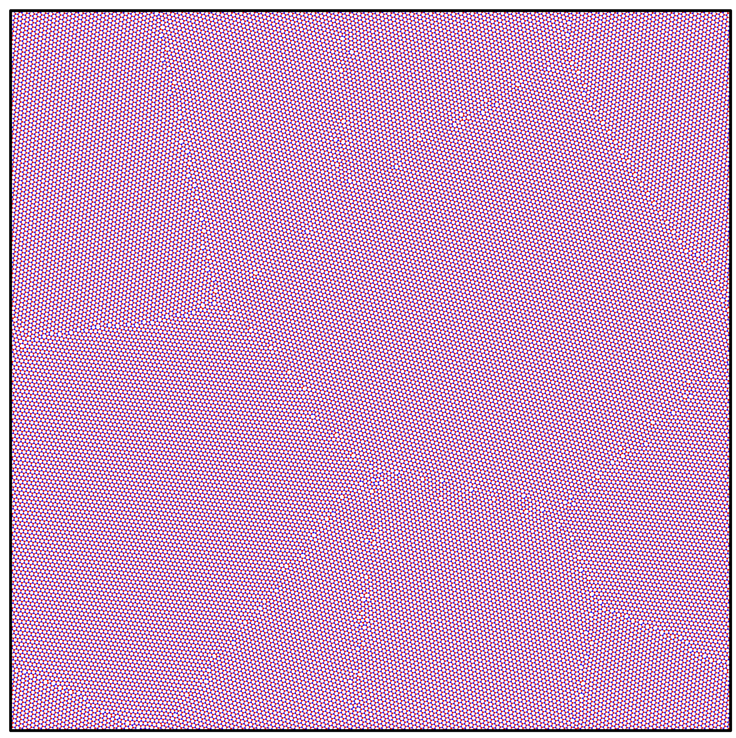
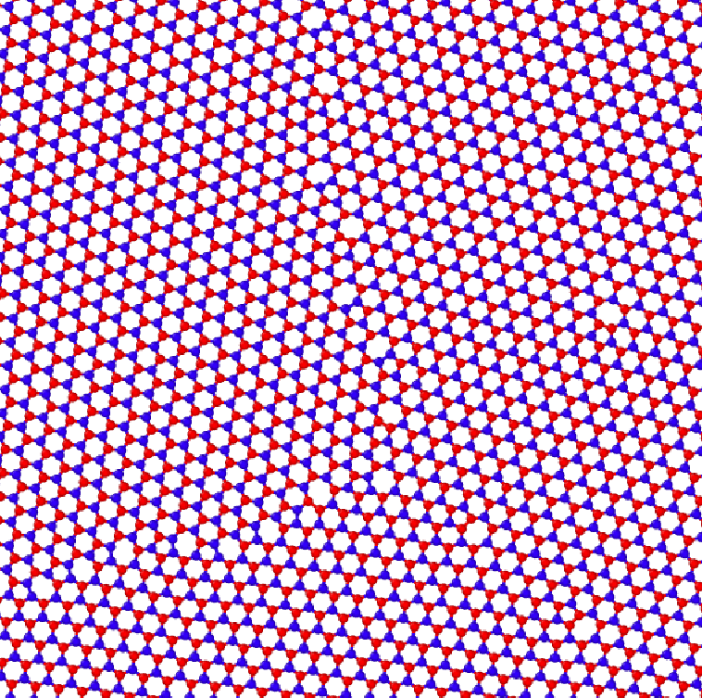
Modules
atom_id.py
It finds the atom id of the shared edges and store them in text file as “same_atom_all.txt”.
type_assign.py
This code can assign the type of atoms for the coordinates and can transform the mono-layer-mono-atomic graphene GB structure to tri-layer-bi-atomic WSe2 GB structure.
400 Angstrom and 5 Grain
Zoomed View

Slide 12
Thank You

